Slide 1
Les compétences enseignantes Teachers competences Overview of the framework Vue d’ensemble du référentiel
If you have not already done so, you can first read about the overall design of the framework in the introduction.

Slide 2
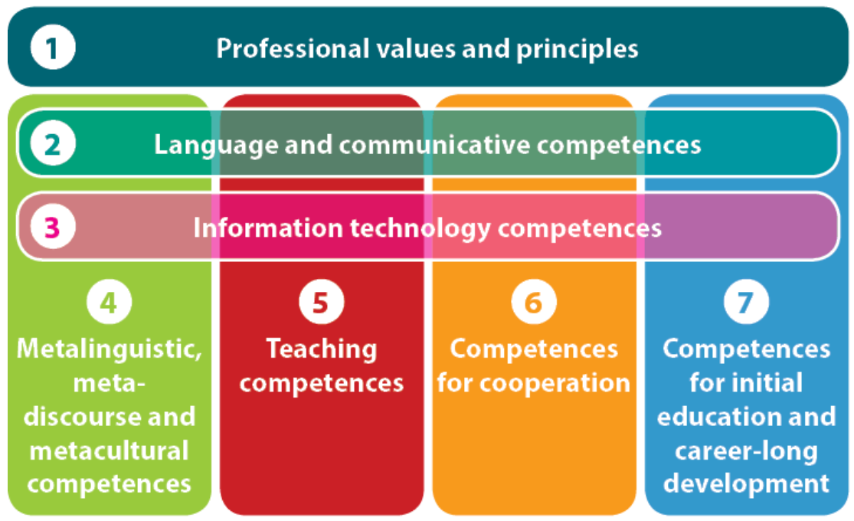
GENERAL STRUCTURE OF THE FRAMEWORK
The framework is organized around the 7 competence dimensions of the inventory proposed by the ECML project A guide to teacher competences for languages in education.

Slide 3
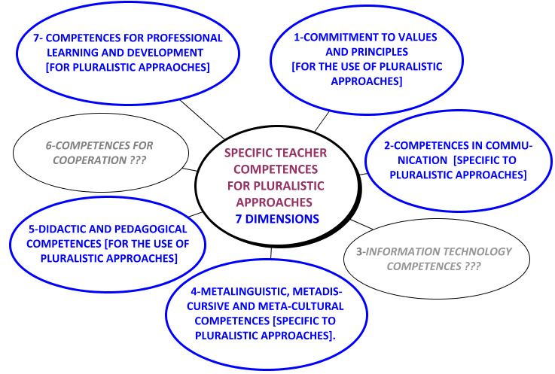
GENERAL STRUCTURE OF THE FRAMEWORK
Current version
7
1
For each dimension, the framework aims to formulate the COMPETENCES that are SPECIFIC to pluralistic approaches.
So far, 5 of the 7 dimensions have been developed
2
6
5
3
4

Slide 4
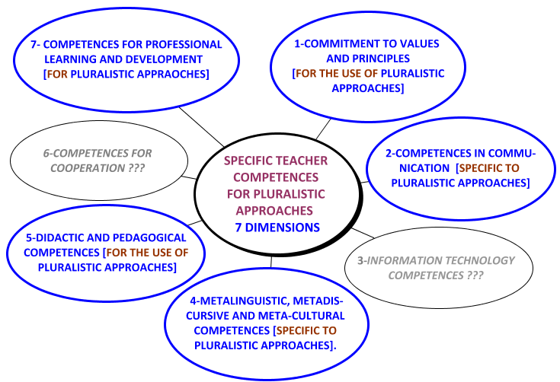
GENERAL STRUCTURE OF OUR FRAMEWORK
Current version
7
1
It has been found that depending on the content of the dimensions, the relationship to plural approaches must be expressed differently.
2
6
You can now discover each of the 5 dimensions that have already been developed
5
3
4

